Slide 1




Year One
Phonics Screening Check
A Guide for Parents

Slide 2

What is Phonics?
Children begin to learn phonics (sounds) in early years, both nursery and reception.
Once children begin learning sounds, these sounds are used orally to identify and make words. They will then begin to learn the letters which make each of the sounds and these are used to read and spell words.

Slide 3
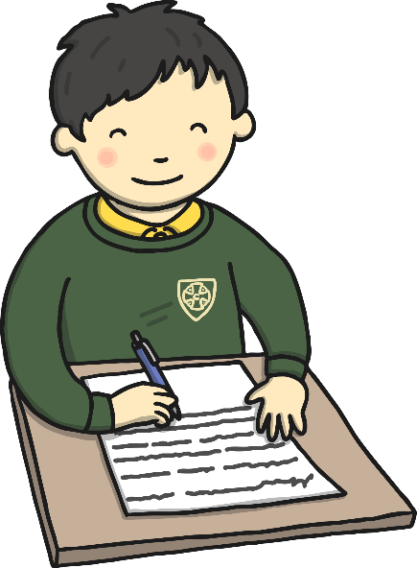
What is the Phonics Screening Check?
The phonics screening check is designed to confirm whether individual children have learnt phonic decoding and blending skills to an appropriate standard.
Children in Year 1 throughout the country will all be taking part in a phonics screening check during the same week from the 10th June 2024.
Children in Year 2 will also take the check if they did not achieve the required result when in Year 1 or they have not taken the test before.

Slide 4

What Happens During the Test?
The test contains 40 words. Each child will sit one-to-one and read each word aloud to a teacher.
The test will take approximately 10 minutes per child, although all children are different and will complete the check at their own pace.
The list of words the children read is a combination of 20 real words and 20 pseudo words (nonsense words or made up words).

Slide 5
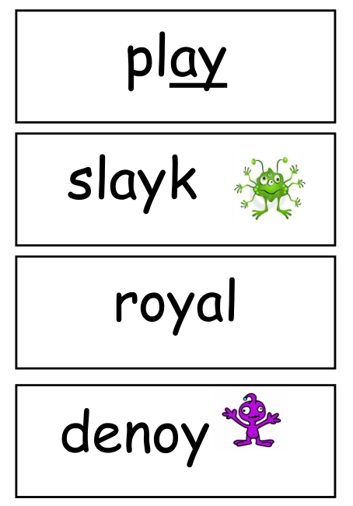
Pseudo Words (Nonsense Words)
The pseudo words will be shown to your child with a picture of an alien.
This provides the children with a context for the pseudo word which is independent from any existing vocabulary they may have.
Pseudo words are included because they will be new to all pupils; they do not favour children with a good vocabulary knowledge or visual memory of words.

Slide 6

How can I help my child at home?
Play lots of sound and listening games with your child.
Read as much as possible to and with your child.
If your child is struggling to decode a word, help them by encouraging them to find the key sound or phoneme and say each sound in the word from left to right.
Blend the sounds by pointing each one e.g. for the word sing say:
/s/, /i/, /ng/. Next move your finger under the whole word as you blend it to read it.
Discuss the meaning of the words if your child does not know what they have read.

Slide 7
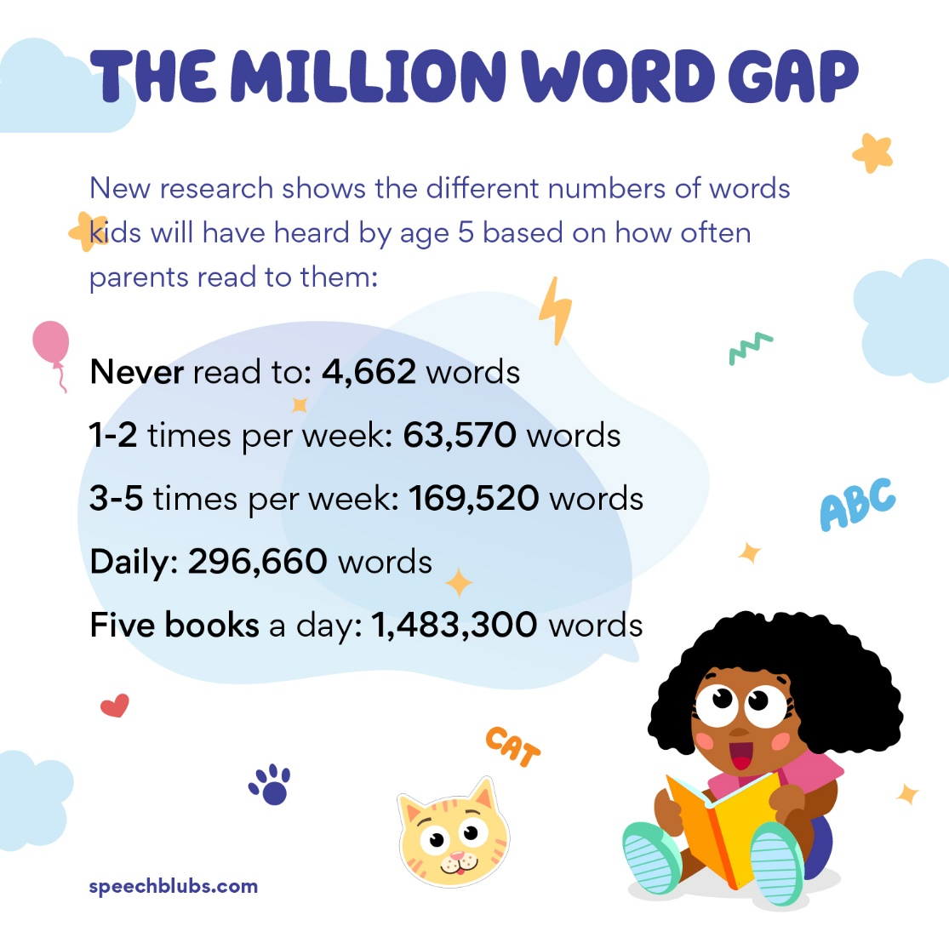
The million word gap
The word gap
Talk a lot families versus little talk
Rich experiences

Slide 8

Reporting to Parents
By the end of the summer term all schools must report each child's results to their parents. They will also confirm if the child has met the standard threshold. Children who do not achieve the expected level will retake the test when they are in Year 2.

Slide 9

How Are the Results Used?
Results from the check will be used by schools to analyse their own performance and for Ofsted to use in inspections. We also use the data to inform future planning.

Slide 10
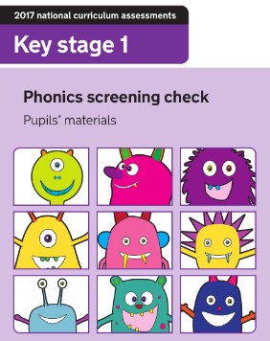
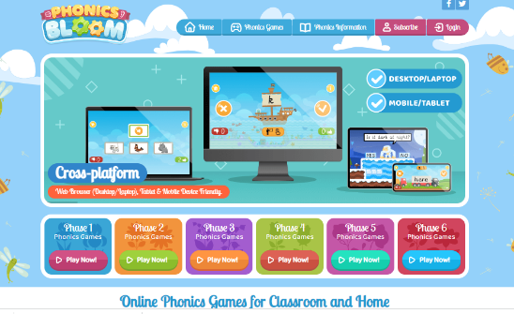
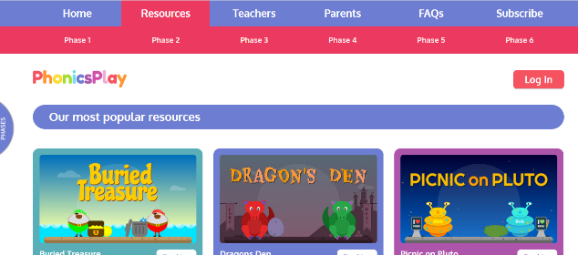
How can I help my child practise at home?
Phonics Screening Check 2018 materials
Phonics Screening Check 2019 materials
Phonics Screening Check 2022 materials
Phonics Bloom
Phonics Play
Previous test papers:

